Slide 1
HOW TO SUCCESSFULLY TEACH DURING A PANDEMIC
Virtual Edition
Katie Hunt
Dr. Fisher
KH 7790
November 15, 2020

Slide 2
Proposal Description
Covid-19 has completely shifted the education experience for teachers and students across the globe. This is especially true for the discipline of health and physical education, a study that incorporates psychomotor, affective, and cognitive domain simultaneously. Physical education requires face to face for adequate learning. The transition to distance learning has and or had many teachers in a bind. Forming questions like: What platforms to use? How can I efficiently transition to virtual learning and engage my students? How do I improve my technological abilities in order to be successful? The PowerPoint aims to answer the unknowns and help new teachers and or student teachers with virtual learning platforms and list pertinent resources for distance learning.

Slide 3
Learning Objectives
Teachers will be able to select a virtual learning platform and video conferencing platform for optimal teaching after the presentation.
Teachers will be able to find solutions to virtual teaching concern(s) with the help of the presentation.
Teachers will be able to incorporate one or more ideas/ concepts from the presentation in order to teach virtual learning successfully.

Slide 4
School Tools: Materials Needed to Teach Virtually
REQUIRED
Computer/ Laptop
Webcam
Microphone
Good Lighting
Stable Connection/ Wi-Fi
Notebook/Planner (any device aiding in organization)
Post-it Notes
Personal Reset Button (Pressed Daily), patience, and optimistic attitude.
OPITIONAL
Second Monitor – Allows you to see students and share screen simultaneously.
Printer- For individuals that need visuals to increase productivity.
Blue Light Blocking Glasses- Blocks light from computers that causes headaches.
Laptop Stand- Reduces Neck and back pain
Wireless Keyboard and Mouse- Reduce Neck and back pain
Seat Cushion- Comfortability during workday

Slide 5
Schools Tool (Technology): Learning Platform
Virtual Platform: These sites help by allowing teachers to execute lesson plans, create new online learning task, and host virtual interactive multimedia classrooms.
Most Popular Virtual Learning Platform: Google Classroom and Microsoft Teams
Other Virtual Platforms (31):
3P Learning
Bloomz
Buncee
ClassDojo
Deck Toys
EdModo
EdPuzzle
Edulastic
Eduplanet
Explain Everything Whiteboard
FlipGrid
Genially
Habyta
Hapara
Kahoot!
Kapwing
Loop
ManagedMethods
Osmo
Parlay
Pronto
Seesaw
Skype
Slack
Schoology
Start.me
StudyBee
Sutori
Webex
Wooclap
Zoom

Slide 6

Learning Platform: Google Classrooms (Option 1)
Free Web Service
Seamless collaboration
Ease of grading
Easy Setup Process
Integrate google drive
Easy and instant ability to post new content, announcements and material
Paperless environment for teachers and students
Students can interact with one another via post
Track Daily Attendance
Ability to reuse projects/assignments for mirroring courses on platform
Assignments can be revisited by students as needed.
Co-teachers can be added
Parents can be invited to monitor student progress
Reminds students of upcoming assignments
Create & administer student exams
Schedule time for assignment to post
Monitor student progress.
It provides a date/time stamp that shows when each student turned in their assignment/project.

Slide 7
Learning Platform: Microsoft Teams(Option 2)
Free
Immersive Reader
Easy to Assign, track, and grade class assignments.
Microsoft Office compatible
Easy access to video conferencing platform.
Consistent Notification Alerts
Increased Productivity
Streamline Communication
Integrate all Office 365 Applications.
PROS

Slide 8


Cons of Learning Platforms
Google Classroom
Microsoft Teams
Uploading of Word documents can cause problem when converting to Google Docs.
Full functioning grade book
Inconsistent notification when students post in the classroom
Glitches for schedule assignments
Uploading of Word documents can cause problem when converting to Google Docs.
Full functioning grade book
Inconsistent notification when students post in the classroom
Glitches for schedule assignments

Slide 9



Schools Tool(Technology):Video Conferencing
Video Conferencing Platforms: Allow teachers to meet with their respective students on a common medium to communicate lessons and the curriculum to be distributed. The limitations of distant learning and real-time communication with the help of the internet is now a problem of the past.
Most Popular Video Conferencing Platforms: Google Meets, Microsoft Teams, and Zoom

Slide 10
Universal PROs & CONs of Video Conferencing
PROs
CONs
Cost Effective- The platforms offered to the students are free.
Enhances Productivity- immediate communication to address concerns/ state information.
No barrier of time- Meetings can take place anywhere. Attendees need a device with a webcam and Wi-Fi
More engaging than audio conferencing
Access anywhere
Technological Issues- Malfunctions can occur at any time for the Host and or the Attendees in the meeting. Lags (slows the computers) can make it impossible for attendees and or the host to understand the content being received/ delivered.
Initially Problematic- The technology can provide issues for the host due to an unfamiliarity. However this can change with time.

Slide 11
Video Platform: Google Meets(Option 1)
Share Screen
Virtual Whiteboard
Record Session
Compatible across devices
Participants can raise hand to alert teacher of questions without disrupting lecture
HD Video and Audio- Exceptional clarity and quality for virtual and hybrid classes.
Security Pin
Controls for meeting host- Mute, Pin, Remove All Participants
Adjustable layout and
Option to Allow students to Share Screen
Disable chat
Live captioning during meetings- Accessibility
Messaging with participants
Integration with Google and Microsoft Office apps

Slide 12
Video Platform: Microsoft Teams(Option 2)
Share Screen
High Quality video and audio calling
Record Meetings
Chat before, during, and after meetings
Live Captions during meeting
User Friendly Interface.
Customized Backgrounds
Raise Hand Feature
Mute All Participants at once
Participant List (Can be downloaded after meeting)
Disable chat
Remove Disruptive Student from meeting
Share From Any Device
Share Files during meeting
Security Pin

Slide 13
Video Platform: Zoom(Option 3)
Share Screen
Virtual Whiteboard
Chat Panel
Record Session- allow students to learn at their own pace.
Breakout Rooms for collaborative work
Virtual Backgrounds
Participants can raise hand to alert teacher of questions without disrupting lecture
HD Video and Audio- Exceptional clarity and quality for virtual and hybrid classes.
Enable Waiting Room
Mute All Participants at once
Option to Allow students to Share Screen
Disable chat
Allow Co-Host- Great for co-teachers
Remove Disruptive Student from meeting
Create a virtual seating chart
Accessibility for all learners- Ensures that every student can participate equitably with closed captioning and keyboard shortcuts.
Security Passcode

Slide 14


Successful Methods for My Teaching During a Pandemic
Little to no technical difficulty
HD quality service
Free
Unlimited time for meetings
Advanced screen sharing capabilities
Easy Interface to access for student and teachers
Free for all users
Compatible with the county’s existing platforms

Slide 15


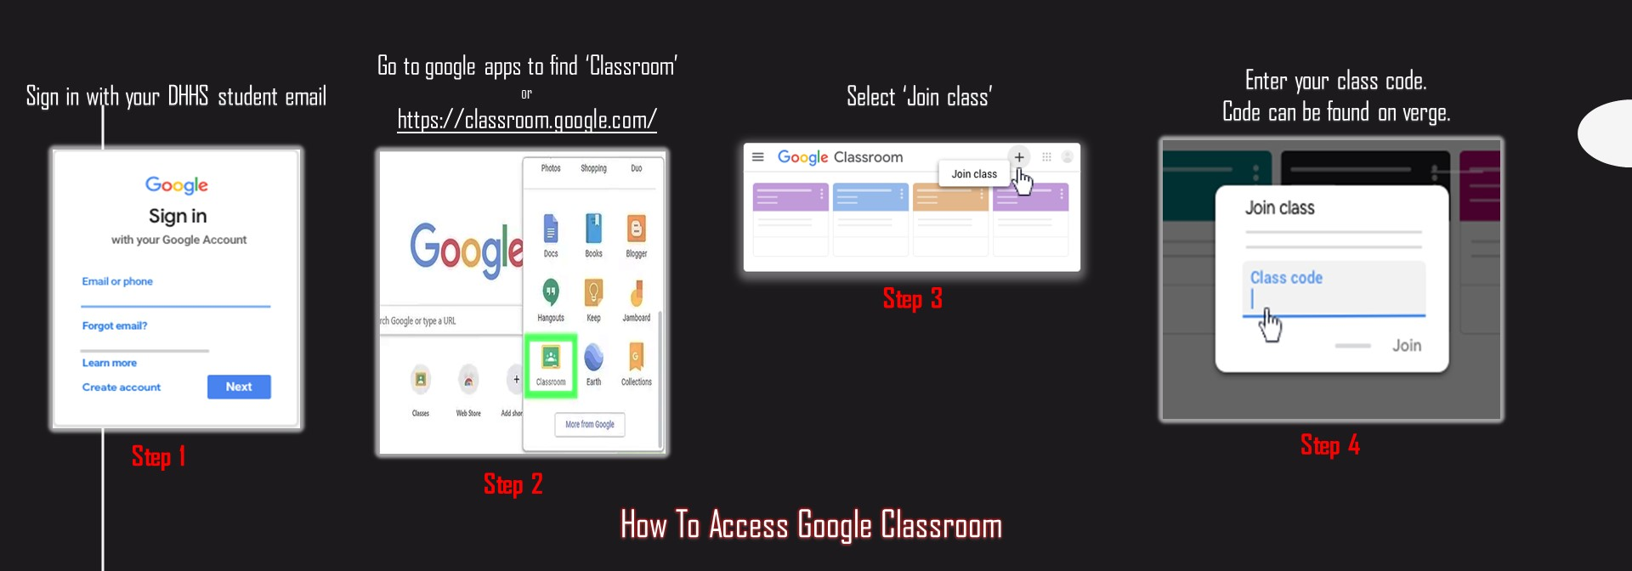
Successful Methods for my Teaching During a Pandemic
How Students Access Google Classroom

Slide 16


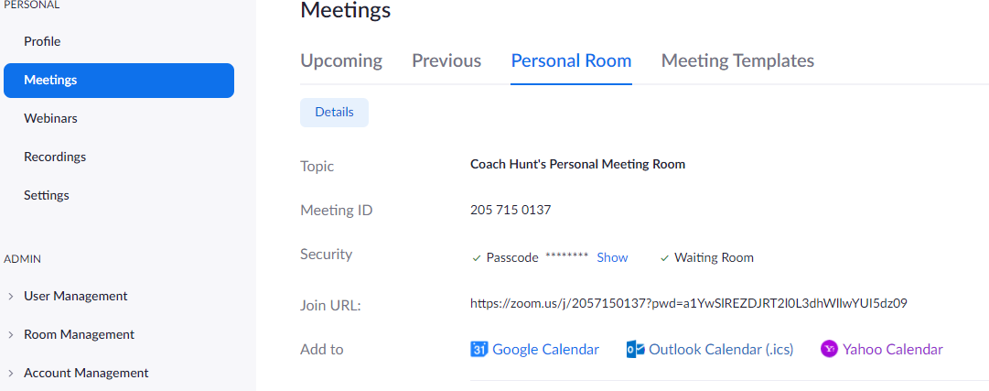
Successful Methods for my Teaching During a Pandemic
How Students Access Zoom Meeting
Link: https://zoom.us/
Teacher View
Students Enter Meeting ID
and Passcode to
Join Meeting

Slide 17
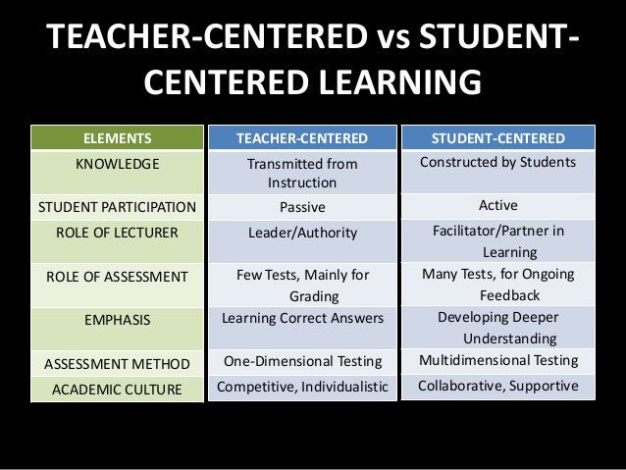
Successful Teaching Methods During a Pandemic: Teaching Style and Delivery Instruction
Virtual learning causes for both teacher-centered and student-centered learning.
By implementing both teaching styles student engagement is higher.
Both teaching styles are combined and incorporate in my teaching style.

Slide 18
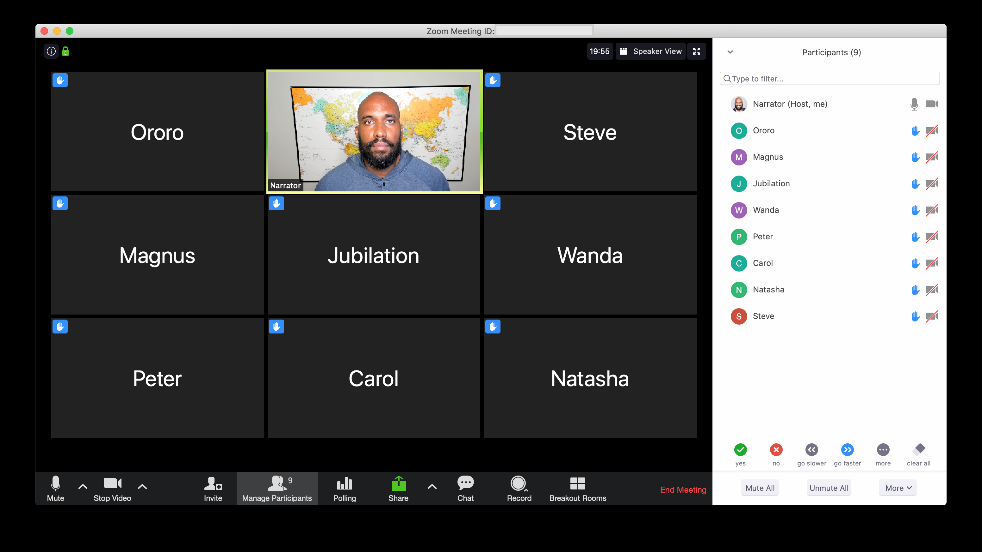

What has been most challenging while teaching during a pandemic?
Low student involvement and student engagement was the most challenging of the pandemic. (No cameras or microphones)
Student’s Initial shyness
H
How to overcome challenges?
Optimistic Attitude
Personal Reset Button (Pressed Daily)
Look for solutions when met with challenges
Create small task that cause for student involvement. (My personal solution in next slide)

Slide 19


Successful Teaching Methods During a Pandemic
In order to ensure student engagement I ask the students to put a letter, number, or special character in the chat before moving on to the next point at various stages in the lesson to check for understanding. Engagement is higher with that implementation.
Before Implementation
After Implementation

Slide 20
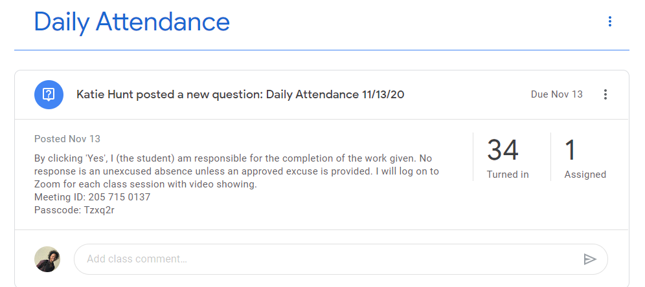
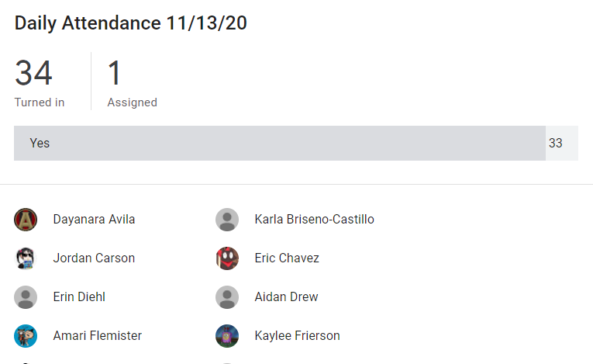

Successful Teaching Methods During a Pandemic: Protocols (Attendance)
Attendance taken via Google classroom
Track Students Daily
Documented Throughout the Entire Course
Time- Stamped
Scheduled to Appear a Specific Time
Parents can take notice

Slide 21
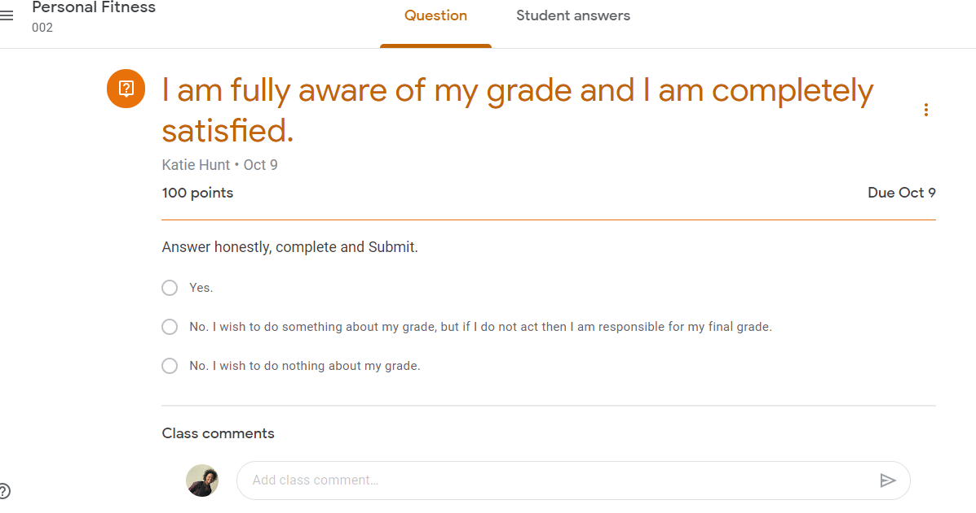
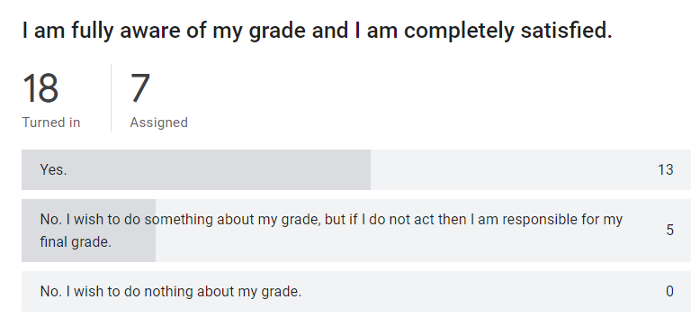
Successful Teaching Methods During a Pandemic: Protocols (Remediation/ Grade Check)
Student (self- assessment) preform evaluation having to research their grade and honestly assess their current standings.
Parents can also read their child’s response in order to track progress.
Administered every 5 weeks to aid in student accountability
Participation grade upon completion

Slide 22

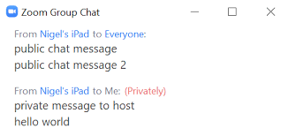
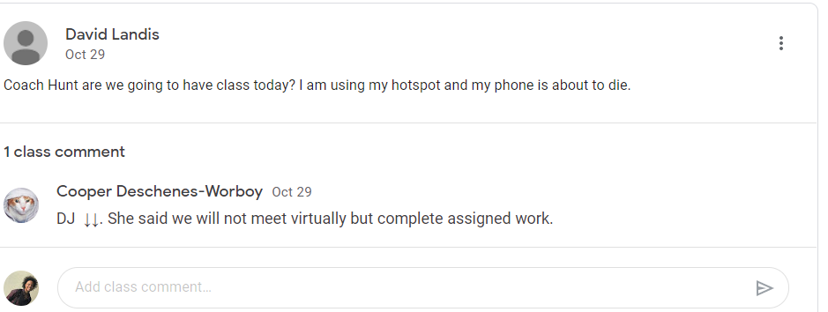
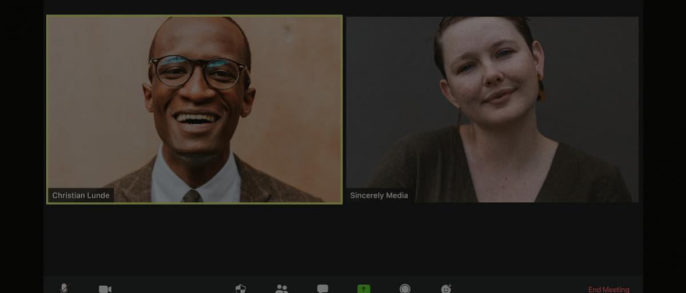


Successful Teaching Methods During a Pandemic: Teacher- Student Communication can occur..
During Zoom Meeting
in Private Chat
Via EMAIL
Google Classroom- Students can comment under announcements or on assignments.
After Class Session via Zoom Meeting for a One-on-One Meeting

Slide 23








Resources used to help you plan for HPE during a pandemic?

Slide 24

Successful Teaching Methods During a Pandemic
You Tube has been an alternative method to deliver the content. YouTube serves as an alternative method/ resource to deliver the content instead of PowerPoints or Google slides every day. Instructional videos provide as another way to engage the students.
A positive trend in student’s test scores are a result of using YouTube as an academic resource. Student can revisit the content whenever they need in order to master the content.
This Photo by Unknown Author is licensed under CC BY-SA-NC

Slide 25
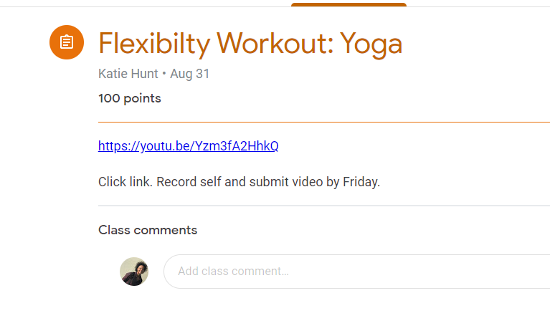

Successful Teaching Methods During a Pandemic
Time allotted during class period so student can complete the exercise(s).
Students can mirror task thus be physical active.
Psychomotor domain can be met with the implementation of task that include movement.

Slide 26

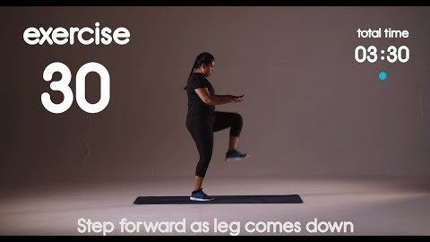
Successful Teaching Methods During a Pandemic
Brain Warmups to Promote Cognitive Stimulation
Personal Fitness Workout
Press
PLAY
Brain warmup (specific activity) used to increase student engagement. Students can respond in chat or aloud. Receive only positive feedback when administering the “brain teasers” via YouTube.
Example of assigned workout

Slide 27

Successful Teaching Methods During a Pandemic
Teacher Pay Teacher is a website that offer content related lessons for teachers.
Somewhat lessens the stress of preparing virtual lessons that engage the students.
Teachers Pay Teachers offers free content
Provide fresh ideas for optimal virtual learning experience.

Slide 28

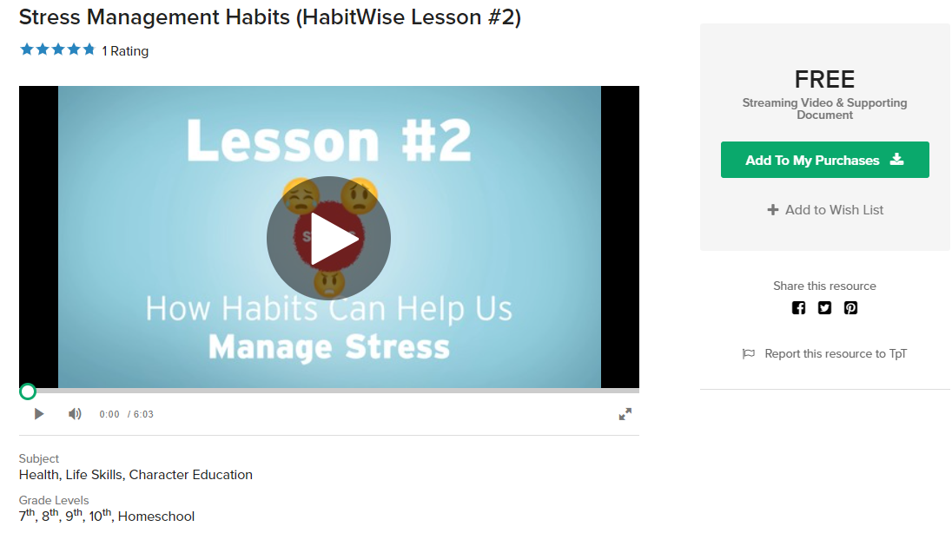
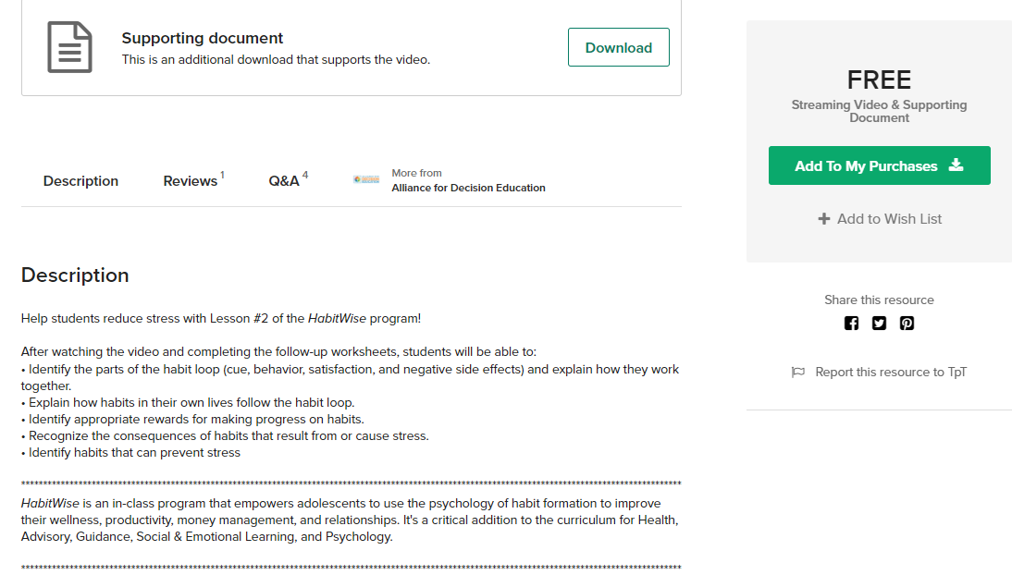
Successful Teaching Methods During a Pandemic
Link: https://www.teacherspayteachers.com/Product/Stress-Management-Habits-HabitWise-Lesson-2-3430851

Slide 29
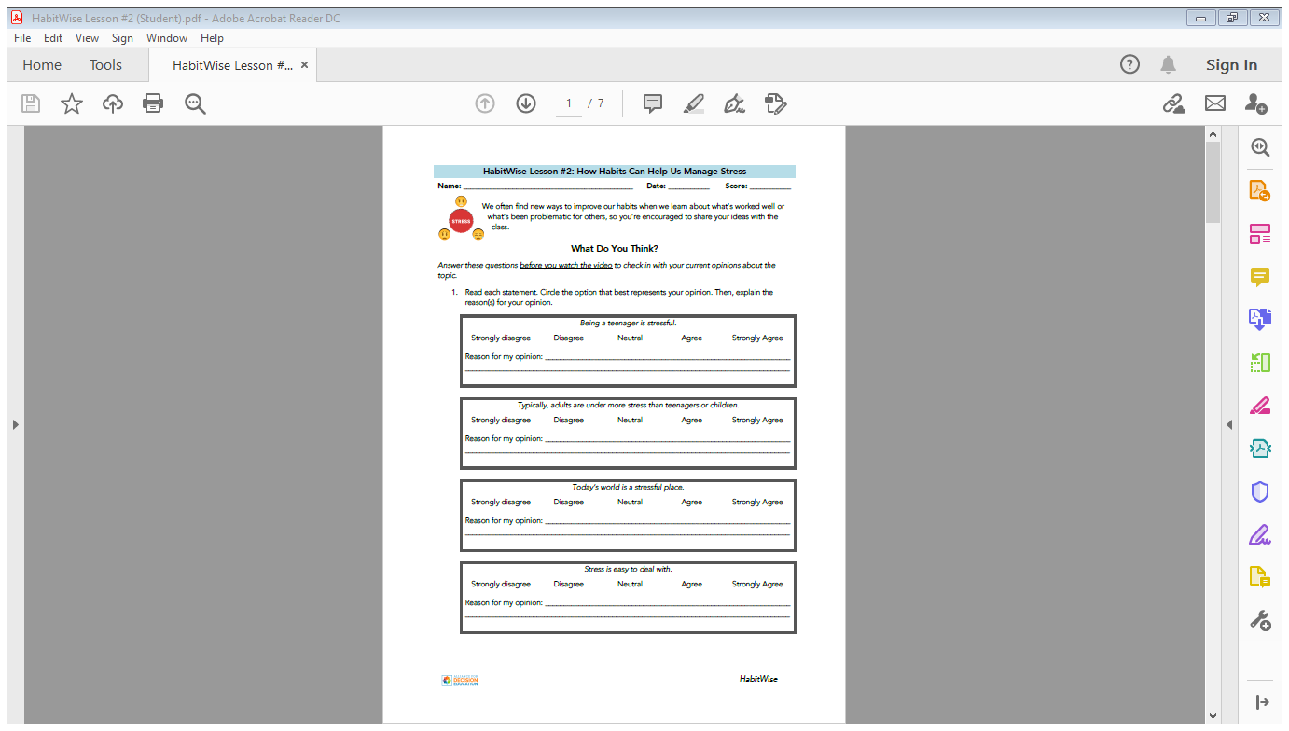
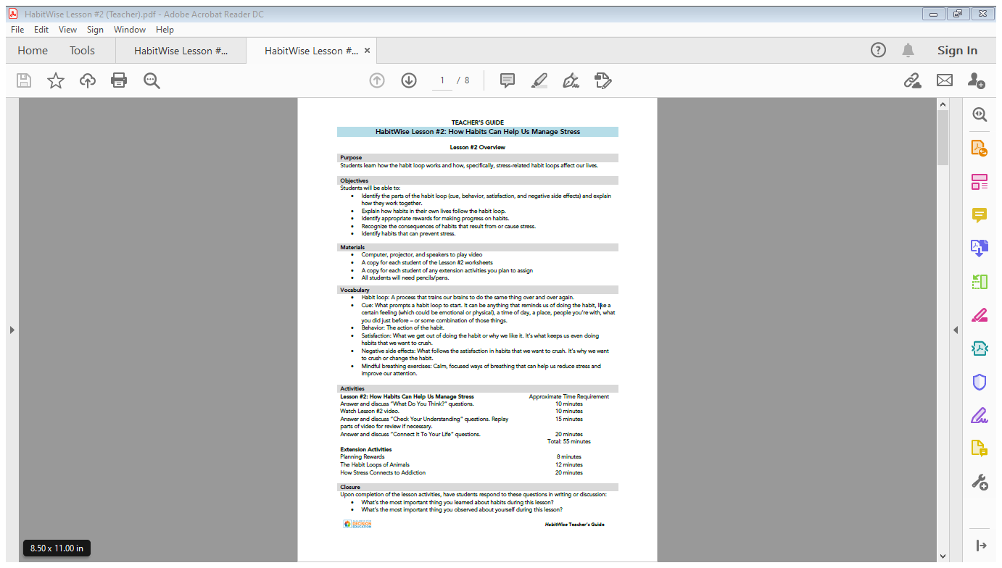
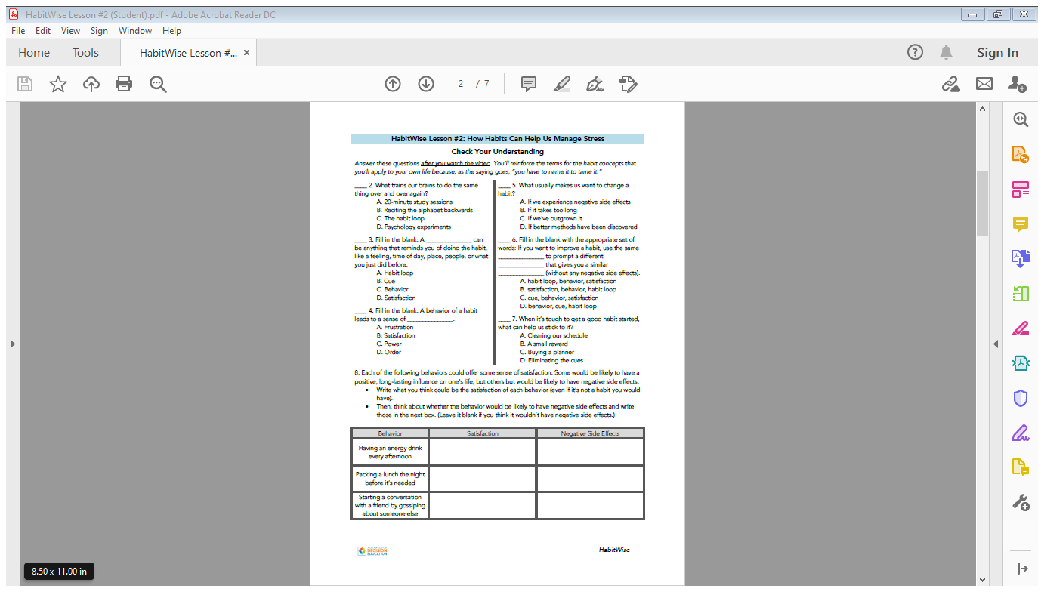
Successful Teaching Methods During a Pandemic

Slide 30

Successful Teaching Methods During a Pandemic
TED-Ed provide a credible educational experience for every student
Brilliant lesson plans for health education teachers.
TED-Ed is free for students and teachers.
The platforms offers an educational video followed by a corresponding multiple choice and short answer questions.
The site also offers additional resources for students to explore and guided discussion to enter an academic conversation around the globe surrounding the topic.
Link: https://ed.ted.com/

Slide 31
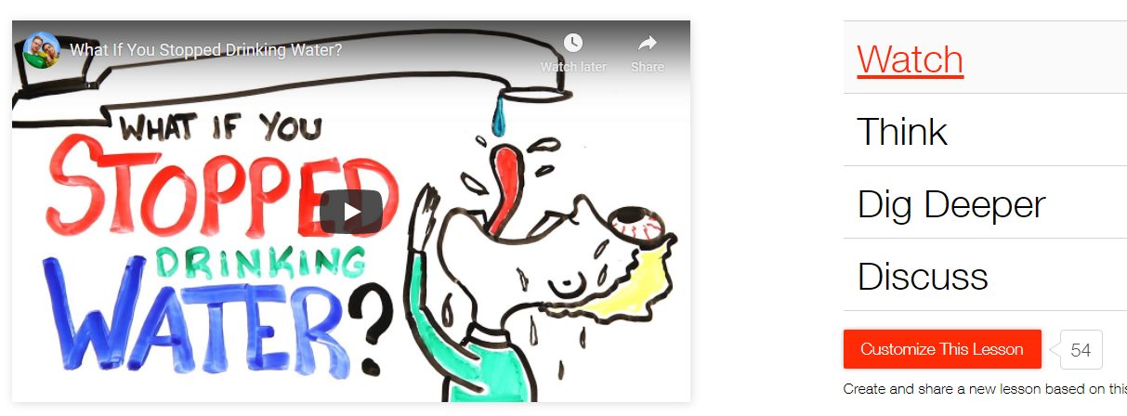
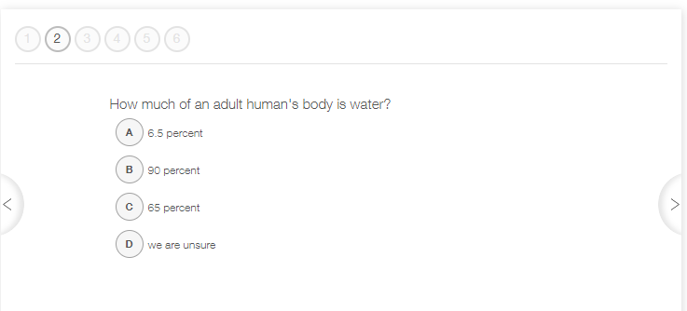

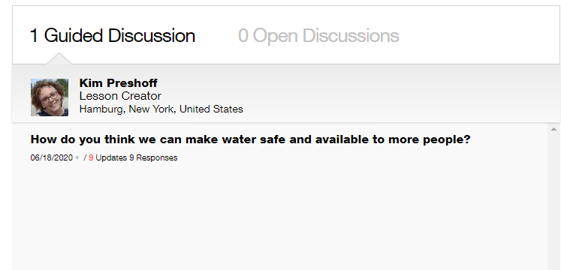
1.
2.
3.
4.

Slide 32

Successful Teaching Methods During a Pandemic
Google Docs has proven to be a valuable resource for successful teaching methods. Google Docs allows for interactive assignments, so the entire class can participate simultaneously. All 34 students can contribute to the completion of an assignment related to the lesson assigned by the teacher.
Assignment: Teacher creates google doc, provide instruction then assigns students a time (3 minutes) to complete task.
Teacher can see the contributors as students work toward the completion of the document.
Example of student- centered learning style.
This task improves student engagement.

Slide 33
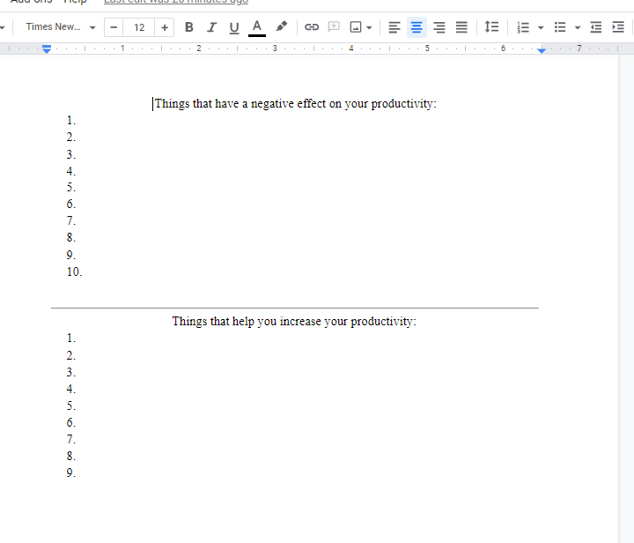
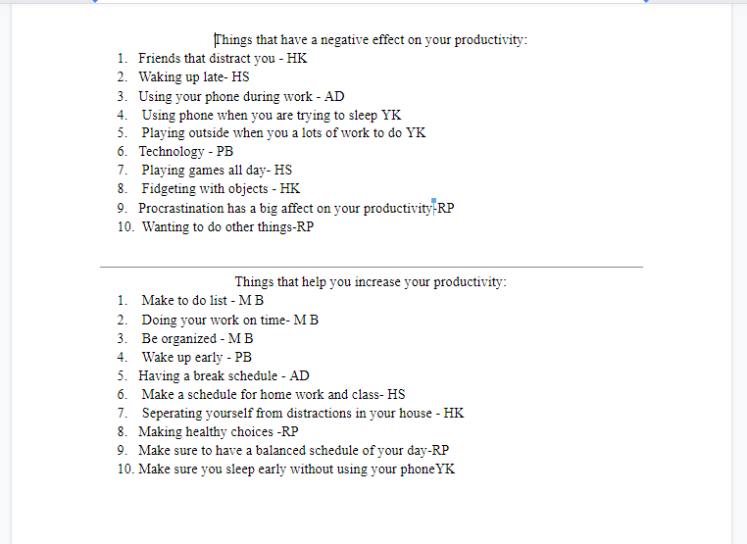



Successful Teaching Methods During a Pandemic
REAL STUDENT RESPONSES

Slide 34

Successful Teaching Methods During a Pandemic: Assessment Method
Google Classroom offers a quiz feature through Google Forms.
Graded Immediately
Options to release the grades immediately or after evaluation.
Assign point values to each question.
Lockmode (Chromebook Only). Lockmode disables the student's ability to open other tabs while taking the test.
The form creates a statistical analysis after the submission of each question that give the teacher insight on the student results.
Quiz Analytics Next Slide

Slide 35
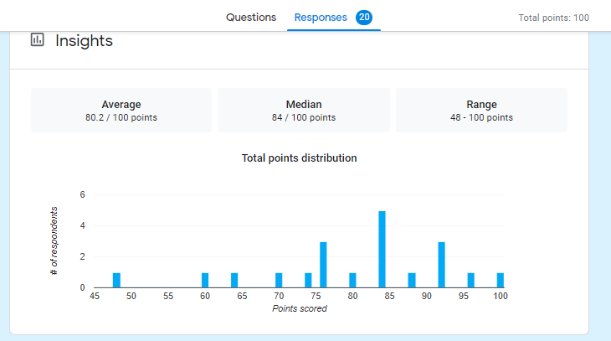
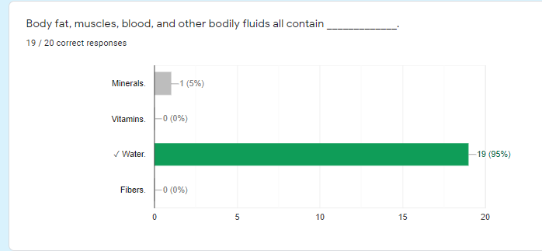
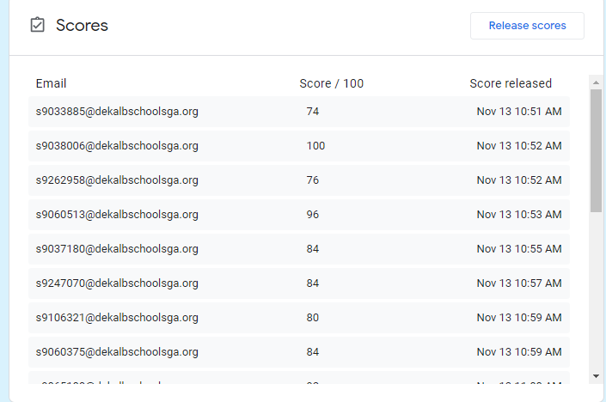
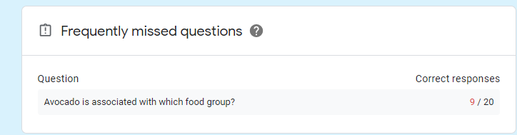
Successful Teaching Methods During a Pandemic

Slide 36

Successful Teaching Methods During a Pandemic
PowerPoint is a vital resource for all teachers whether face to face, hybrid or virtual learning.
PowerPoint can be created, and screen shared to deliver the content in a teacher-centered learning style.

Slide 37
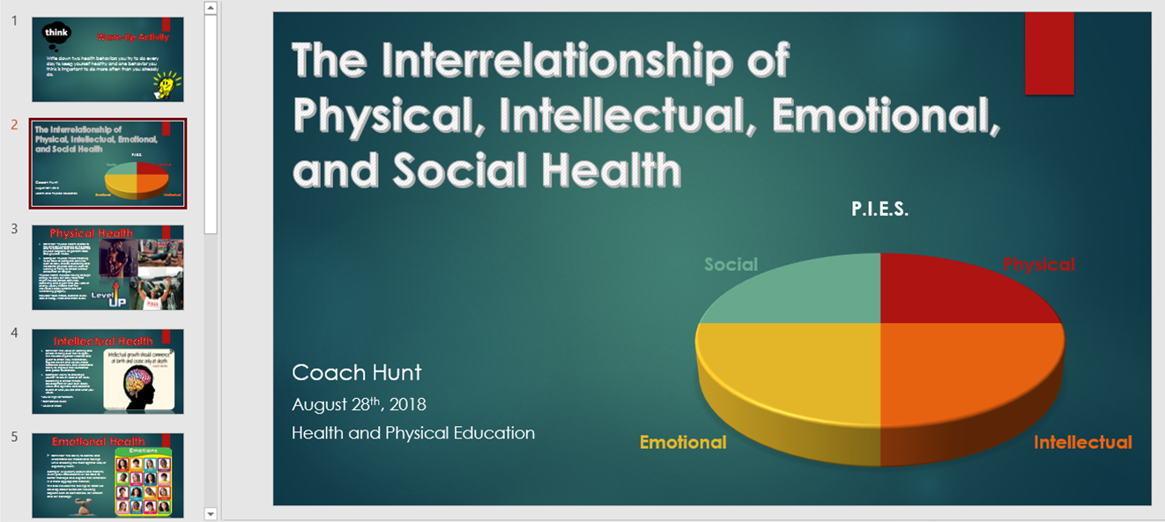
Link for PowerPoint: https://drive.google.com/file/d/1x-NPWqG92DE8SwVkzrw_WL-55e3VcTnb/view?usp=sharing

Slide 38

Successful Teaching Methods During a Pandemic
Implemented to increase student engagement, assessment grades, and serve as a review activity.

Slide 39

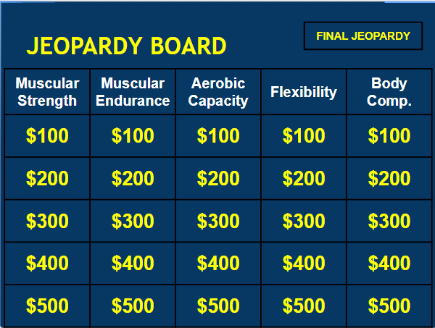


Successful Teaching Methods During a Pandemic
Link to my Jeopardy Game:
https://docs.google.com/presentation/d/1De3Y3rLVT-SewB4n1kukm_9SdHICF9PrL2XgdNFU1Pc/edit?usp=sharing
Link to create Jeopardy Game:
https://docs.google.com/presentation/d/1N_5IbXUY3y2PCuhFQ0YA7ZuREwC7ew1Q3fyILBnEBQA/edit#slide=id.g2b654b397_0490

Slide 40
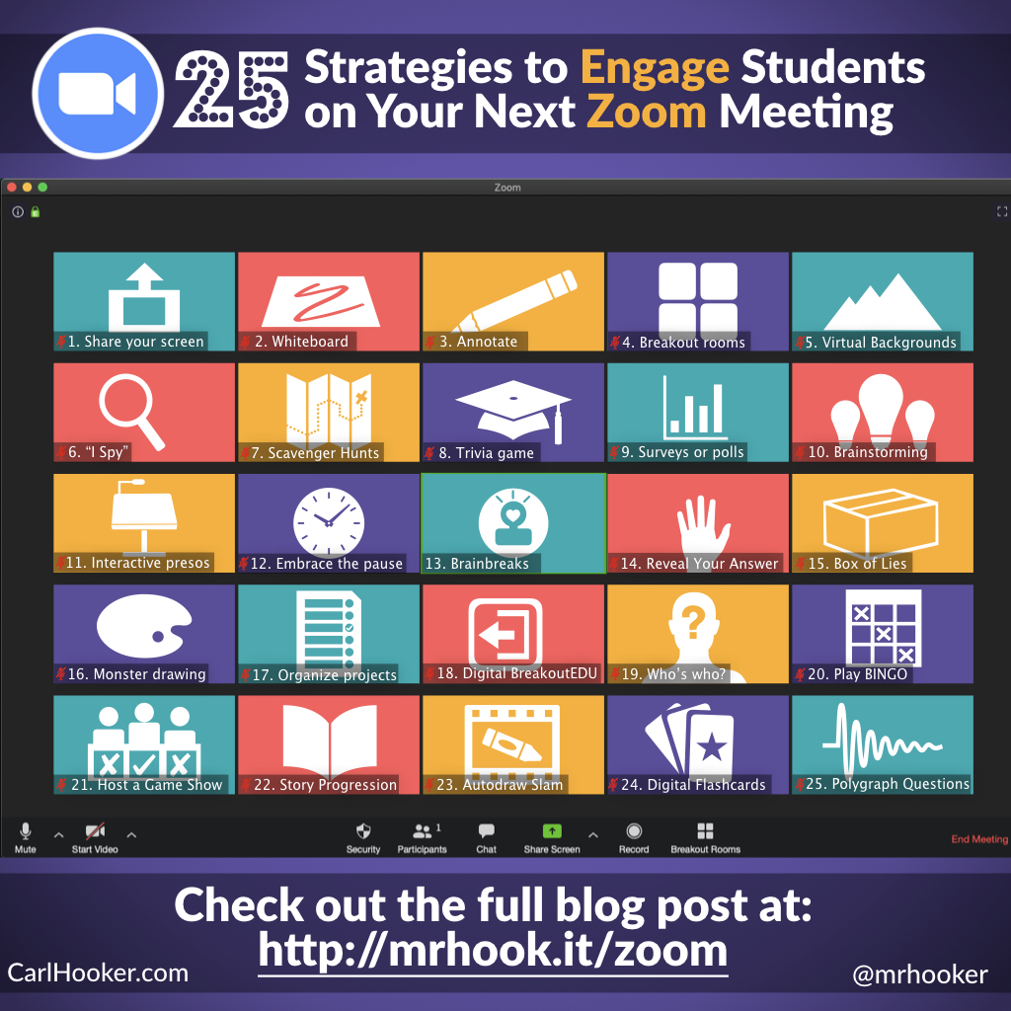
Successful Teaching Methods During a Pandemic: Extra Resources
Link: https://hookedoninnovation.com/2020/05/13/25-strategies-to-engage-zoom/

Slide 41
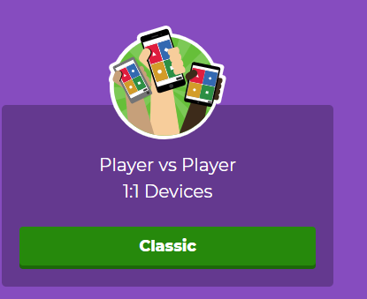

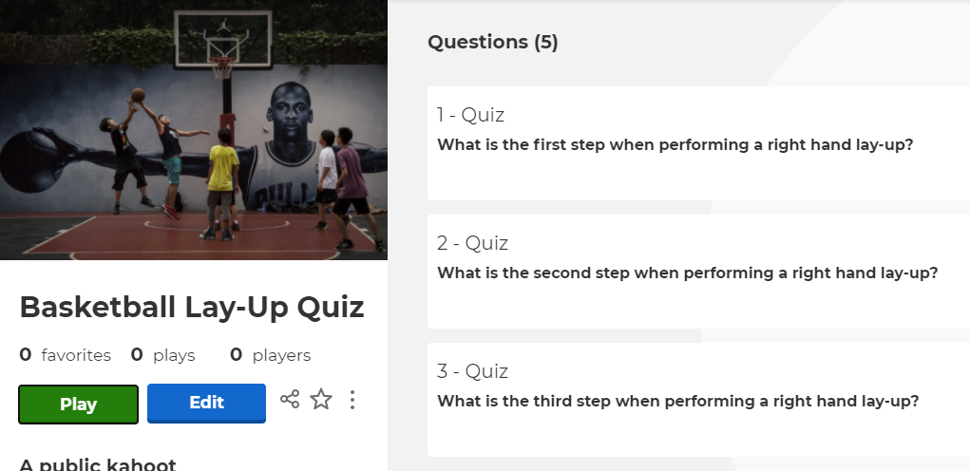
Successful Teaching Methods During a Pandemic
Students can play interactive games while learning content simultaneously.
Students can access Kahoot anywhere.
Teacher can see student participation during task and see scores after task.
Link: https://kahoot.com/schools-u/

Slide 42

Teaching During a Pandemic vs. Face 2 Face
Physical Education is one of the few disciplines that can incorporate affective, psychomotor, and cognitive elements simultaneously. Before the pandemic HPE lessons included more collaborative task amongst peers to accomplish assigned task. The pandemic has eliminated the ability to enhance students’ affective skills with movement (psychomotor skills), but the challenge to create lessons that can execute all three skills are a challenge I do not shy away from. I plan to continue the paperless benefit and incorporate improved differentiated instruction when the pandemic is lifted.
Increased my knowledge of digital platforms.
Ability to go Paperless
Enhanced confidence to deliver distant learning/ hybrid curriculum
Improved my teaching strategies.
Improved student-center learning approach
Sharpened Direct Instruction/ Teacher Centered Learning

Slide 43


ADVICE FOR INCOMING FACULTY MEMBER OR STUDENT TEACHER
Remain Optimistic
Choose a platform that can duplicate course content for future reference
Write down your ideas
Remain Organized
Find solutions before you allow your energy to shift.
Set the tone for your class immediately (rule and protocols)
Try to be a week ahead
Anticipate bad internet connection some days… and be ok.
Work Smarter not Harder
Seek out like minded teachers to exchange thoughts
Reach out to department members for answers and advice
Check your email daily (Stay Informed)
Establish a day and time to meet with parents/ students
Allow self to decompress each day
Find a routine to establish a positive rhythm that will enhance productivity.

Slide 44
Summary
The goal of this presentation is aimed to provide support and relief by informing individuals with pertinent information to teach virtually. Teaching virtually creates many concerns, but with the PowerPoint and time those concern will fade. The presentation includes the top platforms to teach virtually along with the resources needed to create and carryout lesson plans. This presentation will serve as the new teachers’ guide to successfully implement engaging lesson that adhere to the curricula while grooming effective teachers.

